Slide 1

Notes to Instructor
Material Needed
Hard copies of the following:
ADaM Model Document v2.1
ADaM IG v1.1
ADaM Data Structure for Occurrence Data v1.0
ADaM Basic Data Structure for Time to Event v1.0
FDA Study Data Technical Conformance Guide
with labelled Post-It notes attached to the first page of each document
Each participant will need to bring their laptop to access workshop templates needed to complete workshop exercises
Excel file Exercise Templates and additional electronic resources on the External SharePoint site

Slide 2
Electronic Documents Required
ADaM Workshop Module 1.pptx (this power point)
Participants will need the following for exercises:
FDA Study Data Technical Conformance Guide June 2015 (in reference materials)
Lilly ADaM Mod 1 Exercise.xlsx
Lilly Core_TFL_VS_byVisit_V2.xlsx
Lilly Core_ADaM _ADVS_v9.xlsx
Lilly Core_ADaM _ADSL_v7.xlsx
Lilly Core_SDTM _DM_V2.xlsx
For Reference:
ADaM Model Document v2.1
ADaM IG v1.1
ADaM Data Structure for Occurrence Data v1.0
ADaM Basic Data Structure for Time to Event v1.0
FDA Study Data Technical Conformance Guide

Slide 3
Lilly Workshop Module 1 ADaM Overview and Basics

Slide 4
Objectives
Encourage participation to enhance learning in this hands-on workshop
Describe how ADaM fits into the implementation of CDISC standards
Understand the Fundamental Principles of ADaM
Demonstrate an understanding of the principle of traceability
Gain an understanding of levels of ADaM Implementation in a large organization
Describe the types of ADaM metadata

Slide 5
ADaM and CDISC Implementation
Notes:
Note to presenters: The slides 7-14 represent an overview that many in the audience may already be familiar with. Therefore, do not spend lots of time on these slides. They are meant to ‘set the stage’ and provide a quick reminder of how ADaM fits into the CDISC process – and the regulatory process

Slide 6
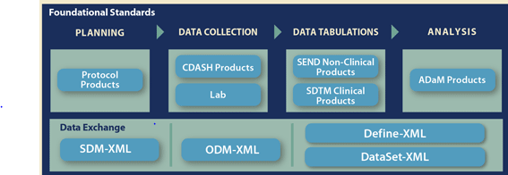
End to End with CDISC Standards
The vision of CDISC has always been the efficient hand-off of data and metadata from one foundational standard to another throughout the life cycle of a clinical trial
Source: www.cdisc.org

Slide 7
Purpose of Analysis Data Sets
Many analyses specified in Statistical Analysis Plan (SAP) require derivation of values and/or observations
Results of these analyses are summarized in tables, figures, and listings in the final study report
The process of defining the algorithms for the derived data and producing the specified analysis is complex and requires detailed documentation and metadata
Validation of this process is equally important and often uses the detailed documentation and metadata

Slide 8
Purpose of ADaM
SDTM is designed for data as collected
ADaM is designed for data as analyzed
ADaM = Analysis Data Model
ADaM is not just about data:
ADaM is designed to support efficient production of analyses
ADaM is designed to support traceability and clear understanding of how data was derived and analyzed

Slide 9
ADaM and FDA

Slide 10

Regulatory Agencies and Standards
Use of standards are advantageous to all reviewers of clinical data
Worldwide regulatory agencies are endorsing or requiring the use of CDISC data standards
US Food and Drug Administration (FDA)- requiring
Japan Pharmaceuticals and Medical Device Agency (PMDA) - requiring
European Medical Association (EMA) - endorsing

Slide 11
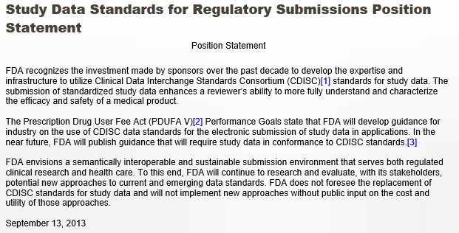
FDA and Standards
Source: http://www.fda.gov/ForIndustry/DataStandards/StudyDataStandards

Slide 12
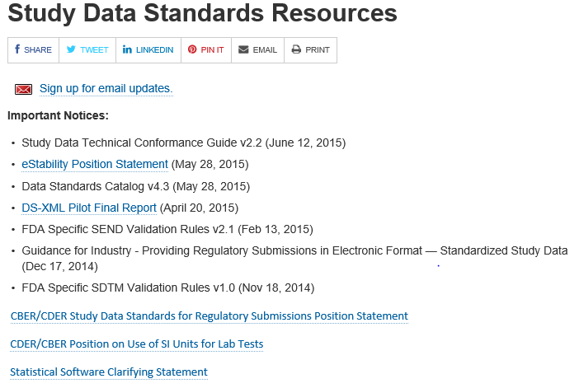
Important FDA Resources
Source: http://www.fda.gov/ForIndustry/DataStandards/StudyDataStandards/

Slide 13
FDA and CDISC – In Brief
According to a published timetable, submission data must use data standards listed in FDA Standards Catalog
If SDTM is submitted, then ADaM ADSL must be submitted
In general, the use of ADaM facilitates review
Alternative structures can be used when necessary
Each analysis data set must have complete and informative metadata

Slide 14
Lilly Module 1 Exercise #1

Slide 15
Exercise #1:
Materials needed:
Study Data Technical Conformance Guide
Lilly Module 1 Exercises.xls
Using the Section noted in Column B of the spreadsheet as reference, answer the questions posed in Column A.
Please save your copy to your local drive – not to the Collaboration Site

Slide 16
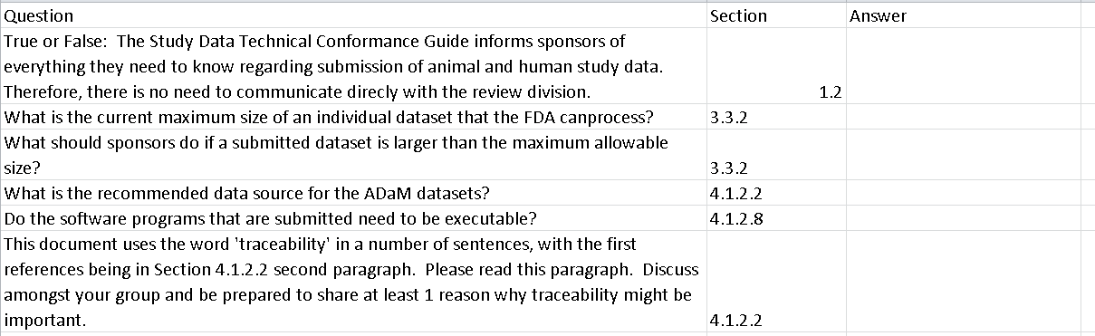
Exercise #1 Questions

Slide 17
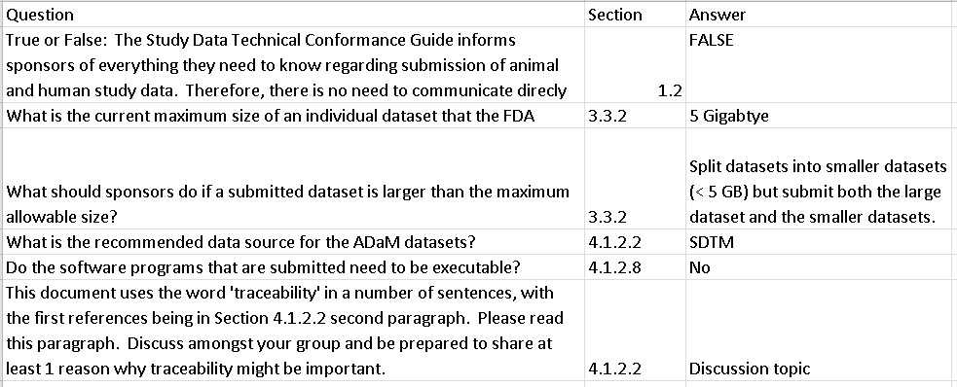
Exercise #1: Answers

Slide 18
ADaM Basic Principles

Slide 19

Fundamental Principles - #1
Analysis data and associated metadata must facilitate clear communication of analyses and conclusions
Inherent in this principle is the recognition that metadata is equally important as the data itself since it is the way to communicate important information such as how a variable was derived

Slide 20
What Is Metadata?
The simple definition of metadata is that it is ‘data about data’
For ADaM purposes, metadata is readable text that provides the user with information about the data.
Examples include;
data set label
variable type
allowable values for a variable
a readable description of how a variable was derived

Slide 21
Fundamental Principles - #2
Analysis data must provide traceability between the analysis data set and the source data (SDTM)
Traceability is an important concept in ADaM because it allows the consumer to understand the lineage of the data
We will discuss how traceability can be achieved in subsequent slides
CRF
SDTM
ADaM

Slide 22
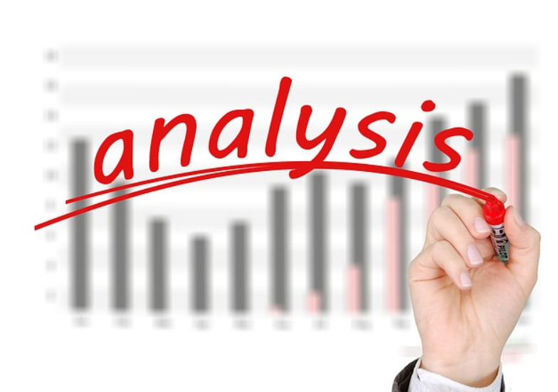
Fundamental Principles - #3
Analysis data must be ‘analysis ready’
Analysis data set must contain the variables and observations needed to produce an SAP specified analysis
No derivations, transposes, or other complex programming during table production
Does not apply to variables needed for table formatting

Slide 23

Fundamental Principles - #4
Analysis data must be readily useable by commonly available software tools
Analysis data set cannot require special software, special import procedures, etc. to be used

Slide 24
Traceability

Slide 25
Traceability Defined
Traceability – The property that enables the understanding of the data’s lineage and/or the relationship between an element and its predecessor(s)
Why is it important?
Traceability supports transparency which supports confidence in statistical results
Ideally traceability should apply to full end to end lineage
End to End: CRF to SDTM to ADaM to TFL’s

Slide 26
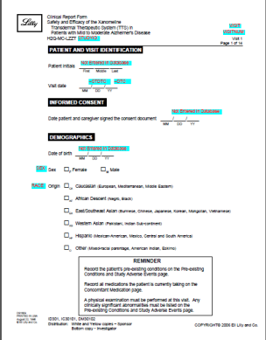
Typical Flow of Standards
USUBJID | AGE | COUNTRY
1001 | 32 | US
1002 | 42 | France
1004 | 19 | Japan
1997 | 85 | Canada
Derivations as
Specified in SAP
USUBJID | AGEGR1 | GEOGR1
1001 | <=35 | North America
1002 | >35 TO <=45 | Europe
1004 | <=35 | Rest of World
1997 | >=65 | North America
SDTM
ADaM
Table 45
Demographic Characteristics
 | Treatment X | Treatment Y
Age Group | N (%) | N (%)
<=35 | 12 (5.2) | 14 (4.8)
>35 to <=45 | 23 (35.7) | 27 (31.3)
CDASH
TFLs in Study Report

Slide 27
Typical Flow of Review / Validation
USUBJID | AGE | COUNTRY
1001 | 32 | US
1002 | 42 | France
1004 | 19 | Japan
1997 | 85 | Canada
I need to check these numbers.
What Variable was used
to create this Age Group
Analysis?
USUBJID | AGEGR1 | GEOGR1
1001 | <=35 | North America
1002 | >35 TO <=45 | Europe
1004 | <=35 | Rest of World
1997 | >=65 | North America
Table 45
Demographic Characteristics
 | Treatment X | Treatment Y
Age Group | N (%) | N (%)
<=35 | 12 (5.2) | 14 (4.8)
>35 to <=45 | 23 (35.7) | 27 (31.3)

Slide 28
Typical Flow of Review / Validation
Ah Ha! – Table metadata tells me it came from variable ADSL.AGEGRP1. But
how was this defined?
USUBJID | AGE | COUNTRY
1001 | 32 | US
1002 | 42 | France
1004 | 19 | Japan
1997 | 85 | Canada
USUBJID | AGEGR1 | GEOGR1
1001 | <=35 | North America
1002 | >35 TO <=45 | Europe
1004 | <=35 | Rest of World
1997 | >=65 | North America
Table 45
Demographic Characteristics
 | Treatment X | Treatment Y
Age Group | N (%) | N (%)
<=35 | 12 (5.2) | 14 (4.8)
>35 to <=45 | 23 (35.7) | 27 (31.3)

Slide 29
Typical Flow of Review / Validation
USUBJID | AGE | COUNTRY
1001 | 32 | US
1002 | 42 | France
1004 | 19 | Japan
1997 | 85 | Canada
USUBJID | AGEGR1 | GEOGR1
1001 | <=35 | North America
1002 | >35 TO <=45 | Europe
1004 | <=35 | Rest of World
1997 | >=65 | North America
ADaM ADSL metadata tells me it was derived from DM.AGE and has 5 possible values. I want to check this derivation…
Table 45
Demographic Characteristics
 | Treatment X | Treatment Y
Age Group | N (%) | N (%)
<=35 | 12 (5.2) | 14 (4.8)
>35 to <=45 | 23 (35.7) | 27 (31.3)

Slide 30
Typical Flow of Review / Validation
USUBJID | AGE | COUNTRY
1001 | 32 | US
1002 | 42 | France
1004 | 19 | Japan
1997 | 85 | Canada
USUBJID | AGEGR1 | GEOGR1
1001 | <=35 | North America
1002 | >35 TO <=45 | Europe
1004 | <=35 | Rest of World
1997 | >=65 | North America
I wonder how was AGE determined?
Was Birthdate collected
and then age calculated
or was AGE simply recorded because of privacy rules?
Table 45
Demographic Characteristics
 | Treatment X | Treatment Y
Age Group | N (%) | N (%)
<=35 | 12 (5.2) | 14 (4.8)
>35 to <=45 | 23 (35.7) | 27 (31.3)

Slide 31
Typical Flow of Review / Validation
Here is Birthdate collected on the CRF. Yay! I clearly see the flow!
USUBJID | AGE | COUNTRY
1001 | 32 | US
1002 | 42 | France
1004 | 19 | Japan
1997 | 85 | Canada
USUBJID | AGEGR1 | GEOGR1
1001 | <=35 | North America
1002 | >35 TO <=45 | Europe
1004 | <=35 | Rest of World
1997 | >=65 | North America
Table 45
Demographic Characteristics
 | Treatment X | Treatment Y
Age Group | N (%) | N (%)
<=35 | 12 (5.2) | 14 (4.8)
>35 to <=45 | 23 (35.7) | 27 (31.3)

Slide 32
Typical Flow of Traceability
USUBJID | AGE | COUNTRY
1001 | 32 | US
1002 | 42 | France
1004 | 19 | Japan
1997 | 85 | Canada
Derivations as
Specified in SAP
USUBJID | AGEGR1 | GEOGR1
1001 | <=35 | North America
1002 | >35 TO <=45 | Europe
1004 | <=35 | Rest of World
1997 | >=65 | North America
SDTM
ADaM
Table 45
Demographic Characteristics
 | Treatment X | Treatment Y
Age Group | N (%) | N (%)
<=35 | 12 (5.2) | 14 (4.8)
>35 to <=45 | 23 (35.7) | 27 (31.3)
CDASH
TFLs in Study Report

Slide 33

Traceability
We perform our work as:
CDASH (CRF) → SDTM → ADaM → TFL’s
Traceability is performed as:
TFLs → ADaM → SDTM → CDASH (CRF)
Traceability is important to EVERYONE! This is not just for regulatory review
Internal Lilly review is equally important
If a reviewer can’t understand how a statistical result was created, they have less confidence in reported conclusions

Slide 34
Lilly Module 1 Exercise #2

Slide 35
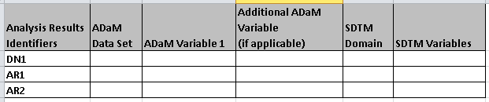
Exercise # 2: Discovering Traceability
Use Core_TFL_VS_byVisit_V2.xlsx
Trace the “Analysis Results Identifiers” on the mock table shell back, and listed below, to:
ADaM data sets & variables
Then ADaM back to SDTM data sets & variables

Slide 36
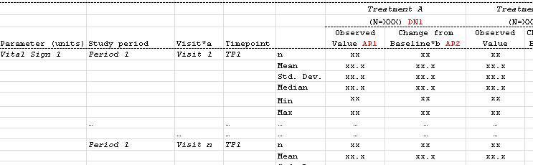
Table: Vital Signs by Visit
Mock Table Shell
Analysis Results Identifiers

Slide 37
Resources
Resources: Excel ADaM Standards for ADVS and ADSL, Excel SDTM Standards for DM, Table Shell for Core_TFL_VS_byVisit_V2.xlsx
These are provided for you on Sharepoint
For this exercise, assume subjects are grouped by “planned treatment”

Slide 38
Exercise #2 Worksheet

Slide 39
Let’s Do the First One Together
DN1 = Denominator - Total number of subjects in treatment group
Open Analysis Results Metadata to find ADaM data set and ADaM Variable

Slide 40
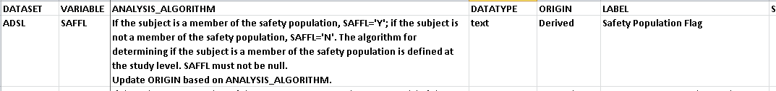
First One Continued…
Open ADSL Standard to find ADSL.SAFFL
For this exercise, lets assume that ANALYSIS.ALGORITHM for SAFFL at the study level states that SAFFL=‘Y’ if DM.RFSTDTC is not missing
Analysis algorithm would be found in the study
level ADSL specification

Slide 41
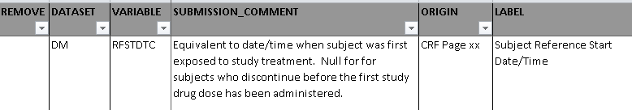
First One Continued…
Open SDTM.DM standard and find definition of RFSTDTC
Discussion: What would be the data source used for programming RFSTDTC?
Notes:
When executing exercise: cannot assume table specs have been used by audience, Review all materials for exercise before exercise
Continue exercise and review after small break

Slide 42
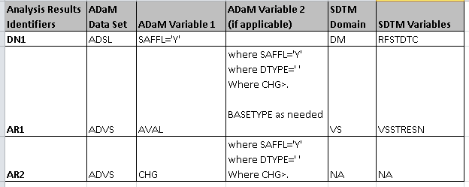
Review of Exercise 2 Answers

Slide 43
The ADaM Standard

Slide 44
What Is the ADaM Standard?
Assumptions (e.g., SDTM is used for creation)
Rules (e.g., the data set ADSL is required)
Required Variables (e.g., at least 1 population flag is required)
Permitted Variables (e.g., SITEGR1 is the variable to use to create site groups if you need it)
Variable name fragments (e.g., *DY)
Classes of data set structures (e.g., BDS)
Metadata elements (e.g., variable level metadata)

Slide 45

The Challenge of ADaM
ADaM is designed to support statistical analysis specified in SAP and protocol
These analyses vary by TA, trial phase, subject population, treatment arms, etc.
Science must be supported
Therefore, the ADaM model has flexibility to allow the educated implementer to make the best decisions based on analysis need

Slide 46
Balancing ADaM Flexibility with Standards
ADaM standards can be developed and enforced using a tiered approach to reduce flexibility
There will be analysis situations where there is no published ADaM solution
Development of a sponsor defined standard solution, within the confines of any ADaM rules, is considered compliant

Slide 47

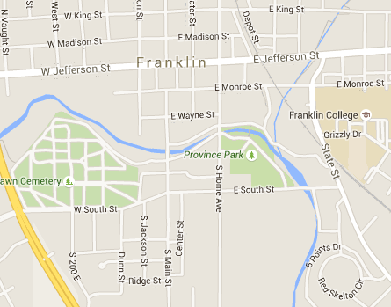
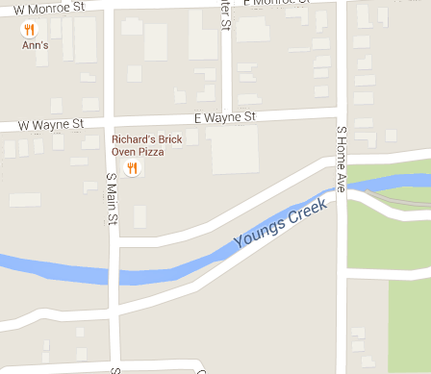
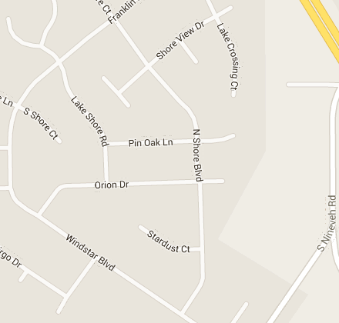
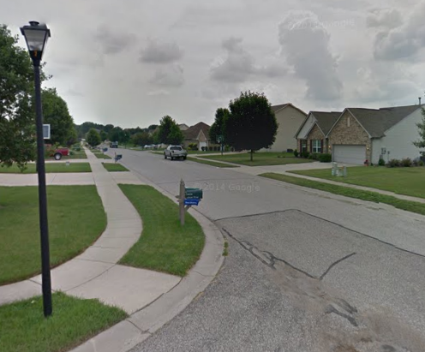
The Google Map of Tiered ADaM Standards
Tier 1: ADaM Standards: General
Directions and orientation to large area
Tier 2: Lilly Standards: Awareness of
major landmarks that help with
navigation
Tier 3: TA Standards: Local neighborhood
and knowledge of where to find local
ethnic restaurants
Tier 4: Compound Standards: Subdivision
of homes built by same builder but with optional add-ons
Tier 5: Individual Study: The street where you live with custom landscaping

Slide 48
Developing and Adhering to Standards
Keep ADaM data sets focused to support the analyses specified in SAP
Taking time to focus on ADaM content is time well spent. Begin with end (TFL’s) in mind
Adding ‘just in case’ content complicates entire implementation process
Lilly has a standard process by which ADaM standards are developed and maintained and this will help build cross-TA uniformity
Use CDASH/CRF and SDTM standards

Slide 49
Introduction to ADaM Metadata

Slide 50
Introduction to ADaM Metadata
All CDISC models define specific metadata and SDTM, SEND, and ADaM share similar concepts
All metadata ends up reflected in Define.xml file, which is required to accompany data in a submission
ADaM principle of clear communication relies heavily on clear metadata
ADaM metadata serves multiple purposes:
Programming specifications
Used for internal validation
Submission requirement

Slide 51
Module 1 Summary
Creation of analysis datasets is an important part of end to end process and are a requirement for submissions
ADaM is the accepted standard to use for submission of analysis datasets to regulatory agencies
The fundamental principles of ADaM should be used for all analysis datasets
Traceability is one of the most important principles in ADaM
Most companies are adapting their processes to use ADaM standards and to develop their own internal standards and governance process for implementation

Slide 52
End of Lilly Module 1 ☺

